Slide 1
Group Equivariant Convolutional Networks Theory and Application
Shaoxuan Chen
Department of Mathematics and Statistics, UMass-Amherst

Slide 2
Outline
0. Deep Neural Network(DNN) and Convolution Neural Network(CNN)
1. General Group Theory
2. Group-equivariant CNNs.
3. Rotation-equivariant Steerable Filter CNNs
4. Scale-equivariant Steerable CNNs
5. Stability of equivariant representation to deformation
6. Experiment Results in Fashion-MNIST Dataset
7. Future Directions

Slide 3
Related Papers
Cohen, T. and Welling, M. Group Equivariant Convolutional Networks. ICML 2016.
Weiler, M and Hamprecht, F A and Storath, M. Learning Steerable Filters for Rotation Equivariant CNNs. CVPR 2018.
Sosnovik, I., Szmaja, M and Smeulders, A. Scale-Equivariant Steerable Networks, ICLR 2020
Zhu, W and Qiu, Q and Calderbank, R and Sapiro, G and Cheng, X. Scaling-Translation-Equivariant Networks with Decomposed Convolutional Filters, JMLR 2022.

Slide 4
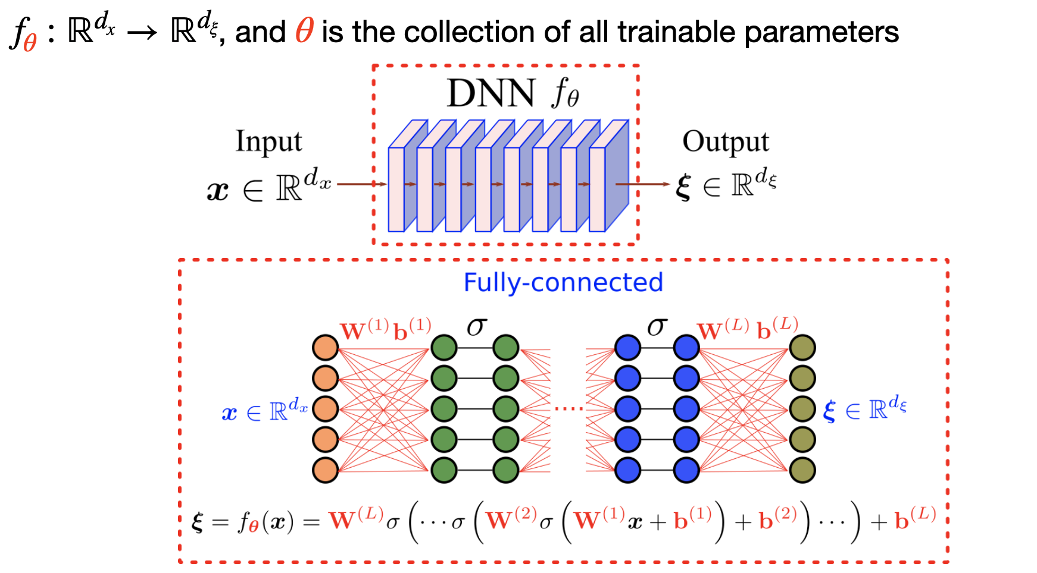
Deep Neural Network

Slide 5
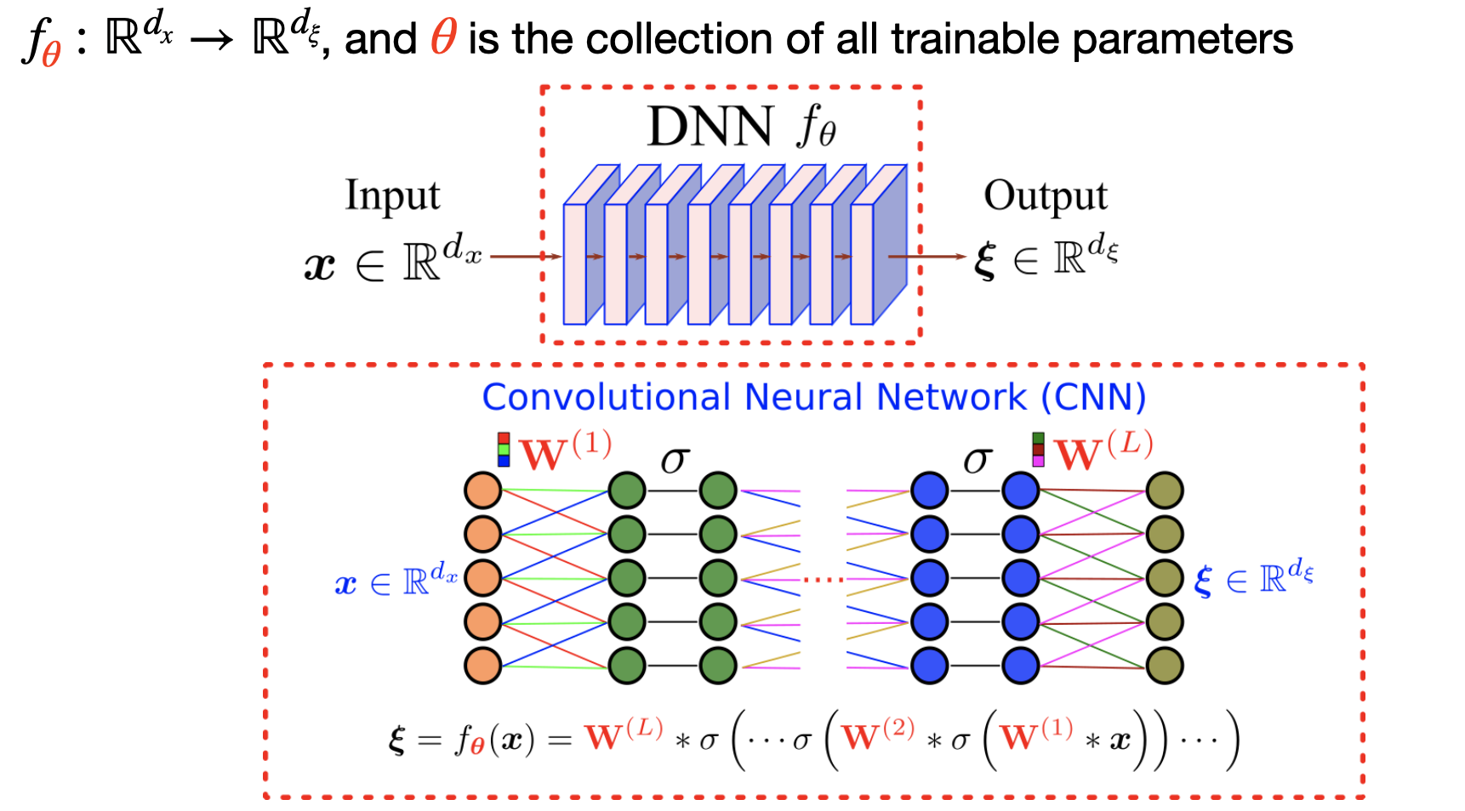
Convolutional Neural Network
Notes:
Ignore the spatial relation between pixels. The networks are invariant to the order of the features

Slide 6
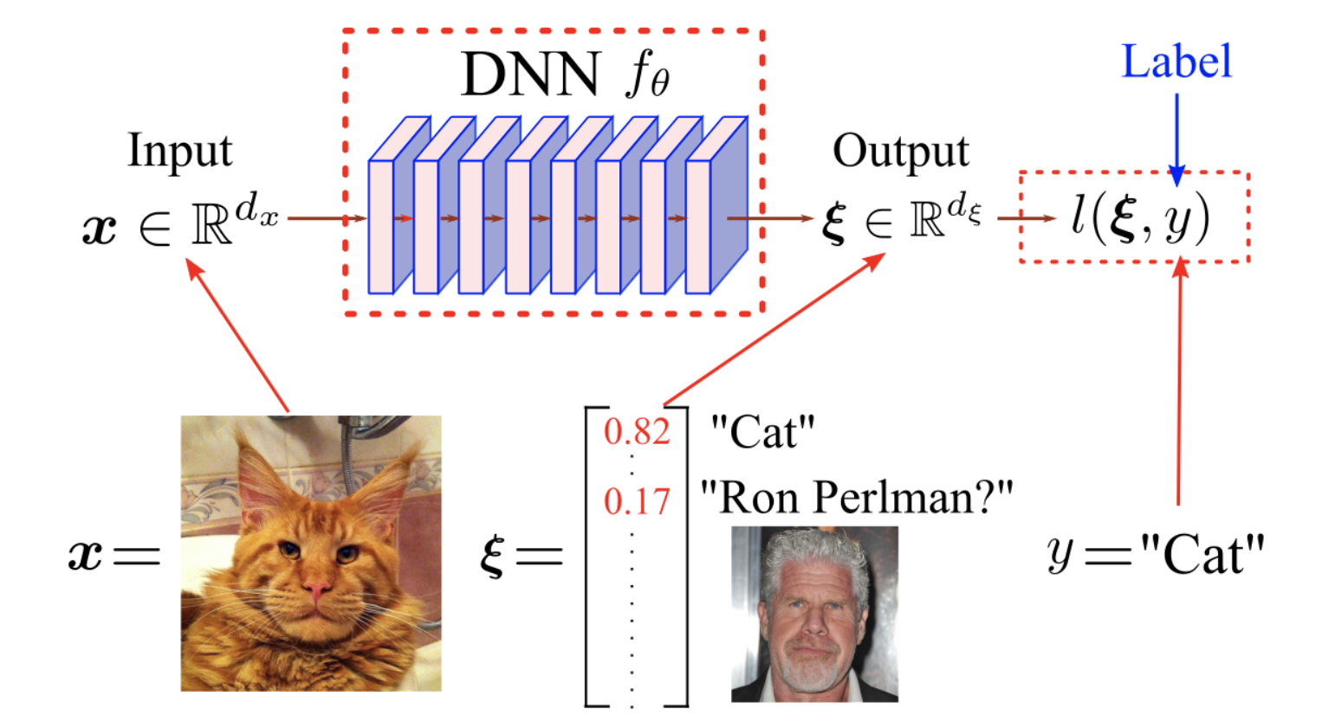
e.g. Image Classification

Slide 7
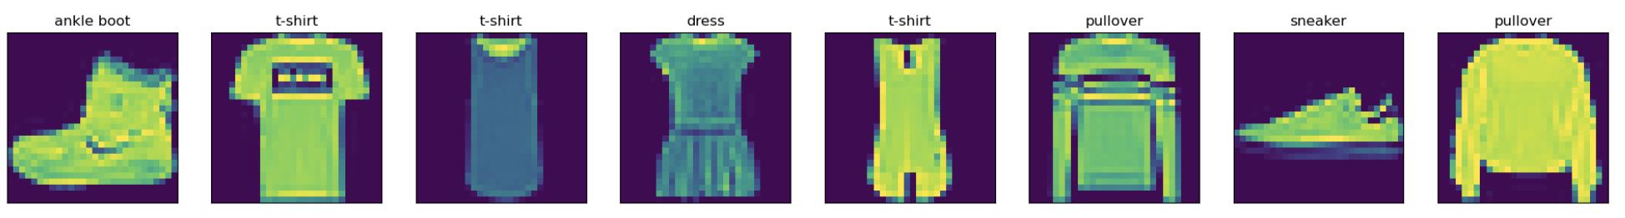
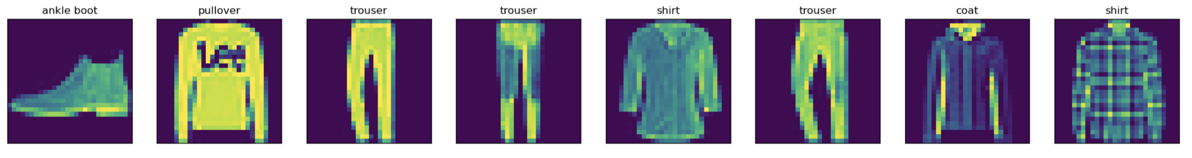
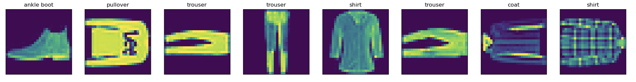
Motivating Example: Classification of Fashion-MNIST Dataset
Training Data:
Testing Data:
Accuracy of the network: 77.9%
Accuracy of t-shirt: 64.5%
Accuracy of trouser: 97.2%
Accuracy of pullover: 72.1%
Accuracy of dress: 78.5%
Accuracy of coat: 61.7%
Accuracy of sandal: 87.4%
Accuracy of shirt: 50.5%
Accuracy of sneaker: 89.5%
Accuracy of bag: 90.5%
Accuracy of ankle boot: 92.6%
Accuracy of the network: 26.0%
Accuracy of t-shirt: 22.4%
Accuracy of trouser: 35.2%
Accuracy of pullover: 19.8%
Accuracy of dress: 23.6%
Accuracy of coat: 20.0%
Accuracy of sandal: 35.6%
Accuracy of shirt: 26.8%
Accuracy of sneaker: 16.8%
Accuracy of bag: 35.8%
Accuracy of ankle boot: 26.3%
Rotated within
{0, 90, 180, 270}
Original
Notes:
Training accuracy:
Testing Accuracy: drop!
So if there is some group transformation on the input, there will not be any good accuracy. So we need to consider the other model/ to construct the other network to produce invariant output, i.e., transform on the input will not affect the output

Slide 8
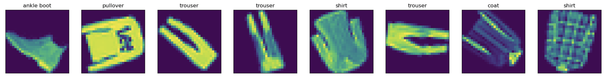
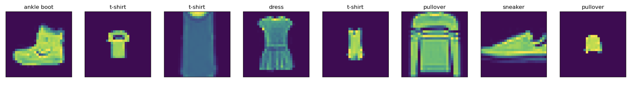
Random Rotate within [0, 360]
Random Scaled
Notes:
When input have scale and rotation variation, cannot have
good results---need neural network that is able to produce group invariant output

Slide 9
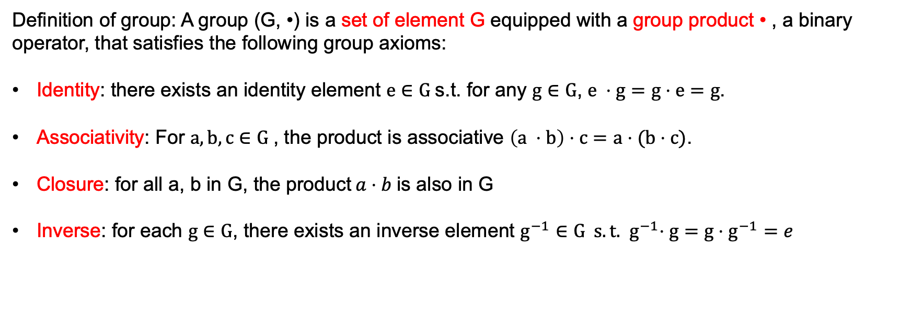
1. Group Theory
1.1. Group
Definition of group: A group (G, •) is a set of element G equipped with a group product • , a binary operator, that satisfies the following group axioms:
Identity: there exists an identity element $e∈G$s.t. for any $g∈G$, $e ⋅g=g⋅e=g$.
Associativity: For $a,b,c∈G$, the product is associative $\left(a ⋅b\right)⋅c=a⋅(b⋅c)$.
Closure: for all a, b in G, the product$a⋅b$is also in G
Inverse: for each $g∈G$, there exists an inverse element $g^{−1}∈G s.t. { g}^{−1}⋅g=g⋅g^{−1}=e$

Slide 10
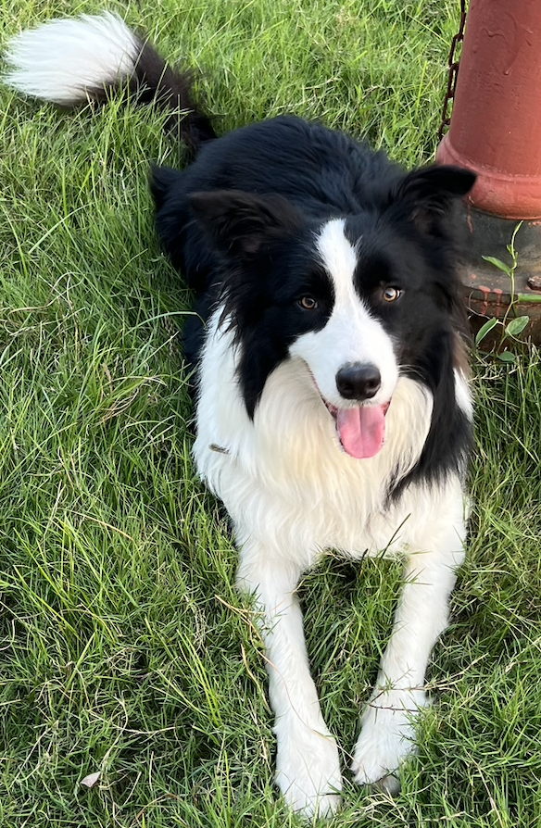


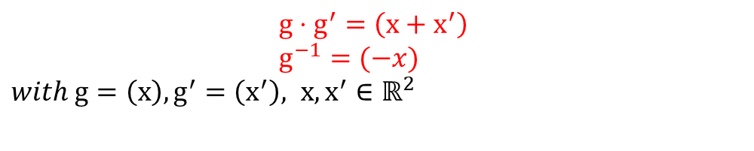
1.2 Translation Group ${(ℝ}^{2},+)$
Consist of all translation in $ℝ^{2}$ and equipped with group product and group inverse:
$$g⋅g^{′}=\left(x+x^{′}\right)$$
$g^{−1}=(−x)$
$with g=\left(x\right), g^{′}=\left(x^{′}\right), x, x^{′}∈ℝ^{2}$
translation by g
translation by g’
translation by $g⋅g^{′}$
Notes:
If we have two group element g and g’, we can combine them by group product.
Add one plot. For group transformation, what is it looks like! For rotation on R2, translation on R2, what are they look like!

Slide 11
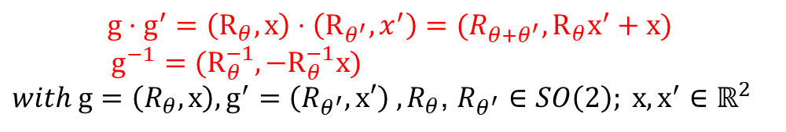
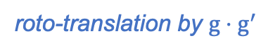

1.3 Roto-translation Group $SE(2)$
The $SE\left(2\right)=ℝ^{2}⋊SO(2)$ consists of the coupled space of $\text{translation} \text{vectors} \text{in} ℝ^{2}$and rotation in $SO\left(2\right),$and is equipped with group product and group inverse:
$$g⋅g^{′}=\left(R_{θ},x\right)⋅\left(R_{θ^{′}},x^{′}\right)=(R_{θ+θ^{′}},R_{θ}x^{′}+x)$$
$g^{−1}=(R_{θ}^{−1},−R_{θ}^{−1}x)$
$with g=\left(R_{θ},x\right), g^{′}=\left(R_{θ^{′}},x′\right) ,R_{θ}$, $R_{θ^{′}}$ $∈SO\left(2\right); x, x^{′}∈ℝ^{2}$
roto-translation by g
roto-translation by g’
roto-translation by $g⋅g^{′}$
Slide credit: E. Bekkers

Slide 12


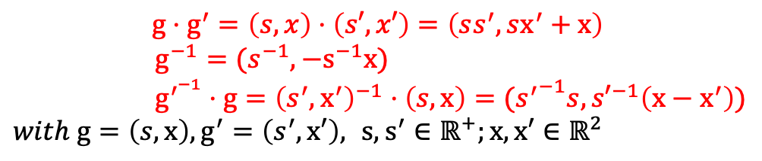
1.4 Scale-translation Group$H$
The group $H=ℝ^{2}⋊ℝ^{+}$ consists of the coupled space of translation vectors in $ℝ^{2}$and scale/dilation factors in $ℝ^{+}$, and is equipped with group product and group inverse:
$$g⋅g^{′}=\left(s,x\right)⋅\left(s′, x′\right)=\left(ss^{′},sx^{′}+x\right)$$
$g^{−1}=(s^{−1},−s^{−1}x)$
$g^{′^{−1}}⋅g={\left(s^{′}, x^{′}\right)}^{−1}⋅\left(s,x\right)=({s^{′}}^{−1}s,{s′}^{−1}\left(x−x^{′}\right))$
$with g=\left(s,x\right), g^{′}=\left(s^{′},x′\right),$ $s,s^{′}∈ℝ^{+};x,x′∈ℝ^{2}$
scale-translation by g
scale-translation by g’
scale-translation by $g⋅g^{′}$
Slide credit: E. Bekkers

Slide 13
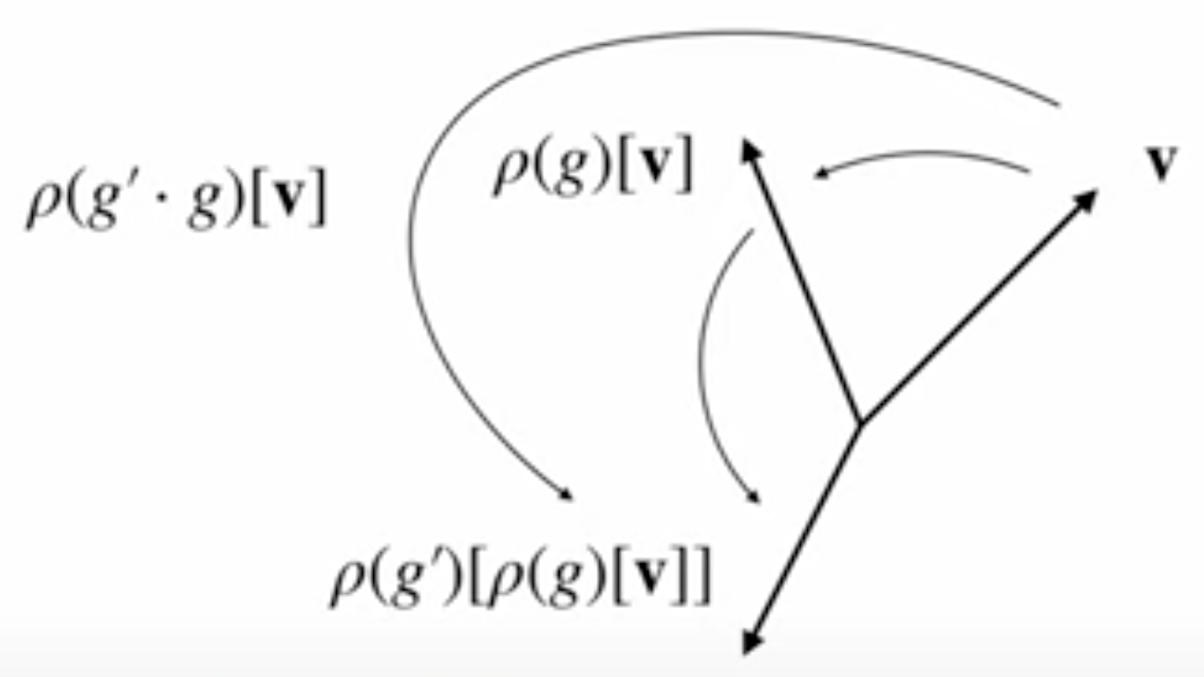
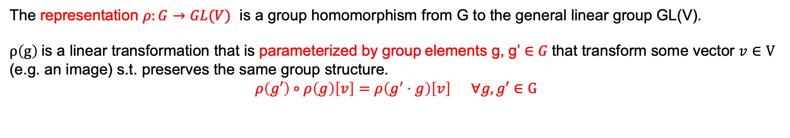
1.5 Group Representation
The representation $ρ:G→GL(V)$ is a group homomorphism from G to the general linear group GL(V).
$ρ\left(g\right)$is a linear transformation that is parameterized by group elements g, g’ $∈G$that transform some vector $v∈V$
(e.g. an image) s.t. preserves the same group structure.
$$ρ\left(g′\right)∘ρ\left(g\right)\left[v\right]=ρ\left(g^{′}⋅g\right)\left[v\right] ∀g,g′∈G$$
Slide credit: E. Bekkers
Notes:
Group homomorphism: if we initially have a group here e.g. group of translation
Group representation are the transformations that respect the group structure in the following way
Plot: vector v, if we have a representation pho which is parameterized by rotation angle for example, which generate this vector. For then rotate it again, say g’ is another rotation angle. End up in this location. Could as well can be done directly by group representation of parameterized by the product of these two.
If we have two group element g and g’, we can combine them by group product.
g, h is x, x’ translation. We have group action: g*h = x+x’= x’ translation first followed up with and x translation addition
What is the general linear group? take any v, within the vector space v, we have,,,,,,,,,above

Slide 14
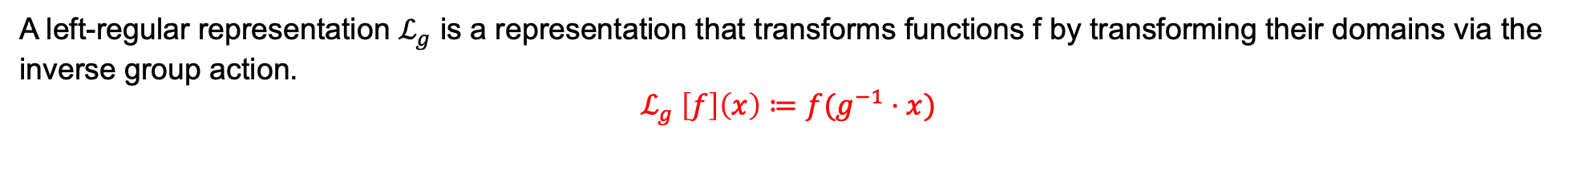
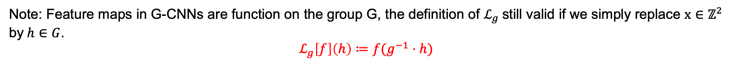
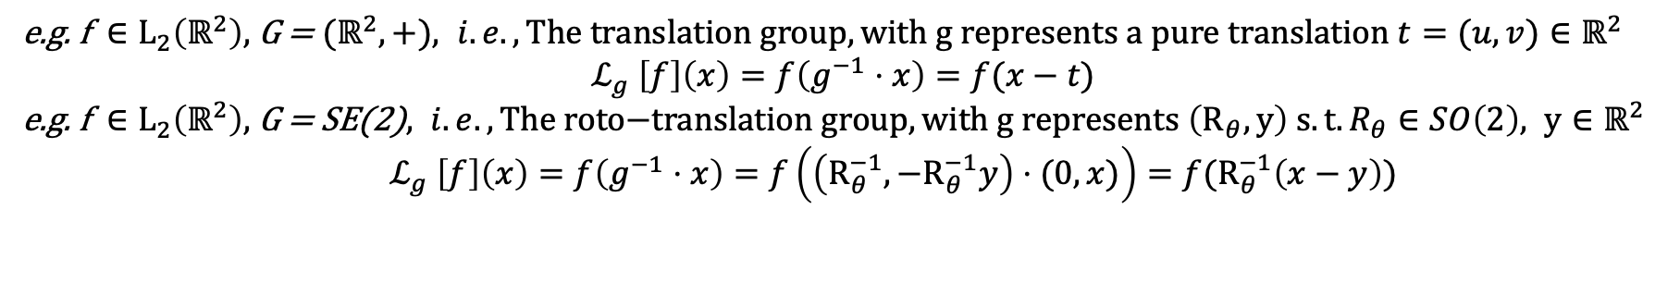
1.6 Left-regular Representations
A left-regular representation $ℒ_{g}$ is a representation that transforms functions f by transforming their domains via the
inverse group action.
$$ℒ_{g} \left[f\right]\left(x\right)≔f(g^{−1}⋅x)$$
e.g. f $∈L_{2}\left(ℝ^{2}\right),$ G = ${(ℝ}^{2},+), i.e.,\text{The} \text{translation} \text{group}, with g represents a pure translation t=(u, v)∈ℝ^{2}$
$$ℒ_{g} \left[f\right]\left(x\right)=f\left(g^{−1}⋅x\right)=f(x−t)$$
e.g. f $∈L_{2}\left(ℝ^{2}\right),$G = SE(2)$, i.e.,\text{The} \text{roto}\text{−}\text{translation} \text{group}, with g represents \left(R_{θ},y\right) s.t. R_{θ}∈SO\left(2\right), y∈ℝ^{2}$
$$ℒ_{g} \left[f\right]\left(x\right)=f\left(g^{−1}⋅x\right)=f\left(\left(R_{θ}^{−1}, −R_{θ}^{−1}y\right)⋅(0,x)\right)=f(R_{θ}^{−1}\left(x−y\right))$$
Note: Feature maps in G-CNNs are function on the group G, the definition of $ℒ_{g}$still valid if we simply replace $x∈ℤ^{2}$ by$h∈G$.
$$ℒ_{g}\left[f\right]\left(h\right)≔f(g^{−1}⋅h)$$
Notes:
g, is like representation on the fuction, group acting on the spaces of functions
This essentially mean that we can transfer this group structure to other type of object, we are not limited to apply group product to a group element. Now we can stick to the group structure by letting the group transform the other type of the object, such as vectors. Images. When we transform the images, we need to talk about the left representation.

Slide 15
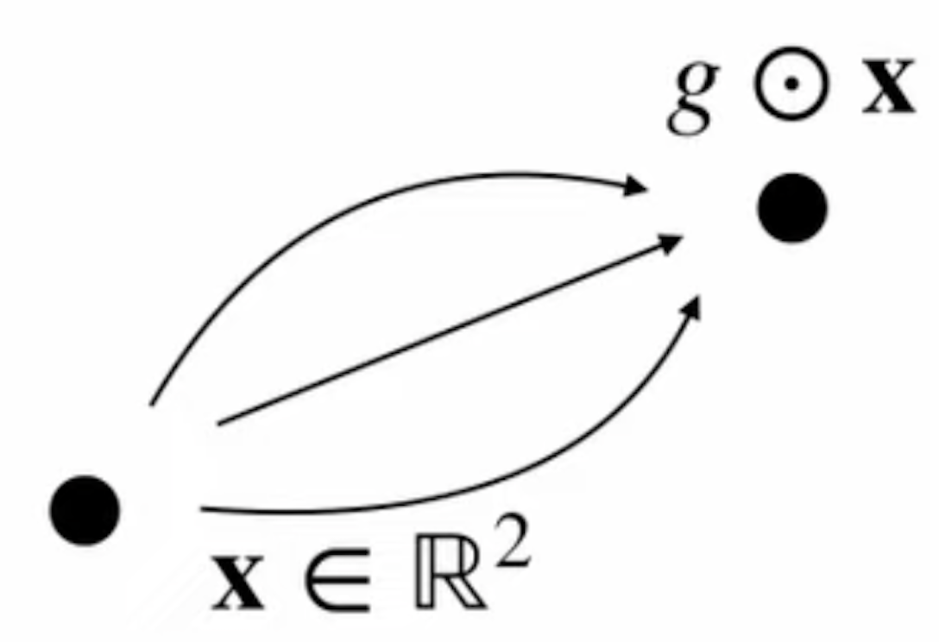
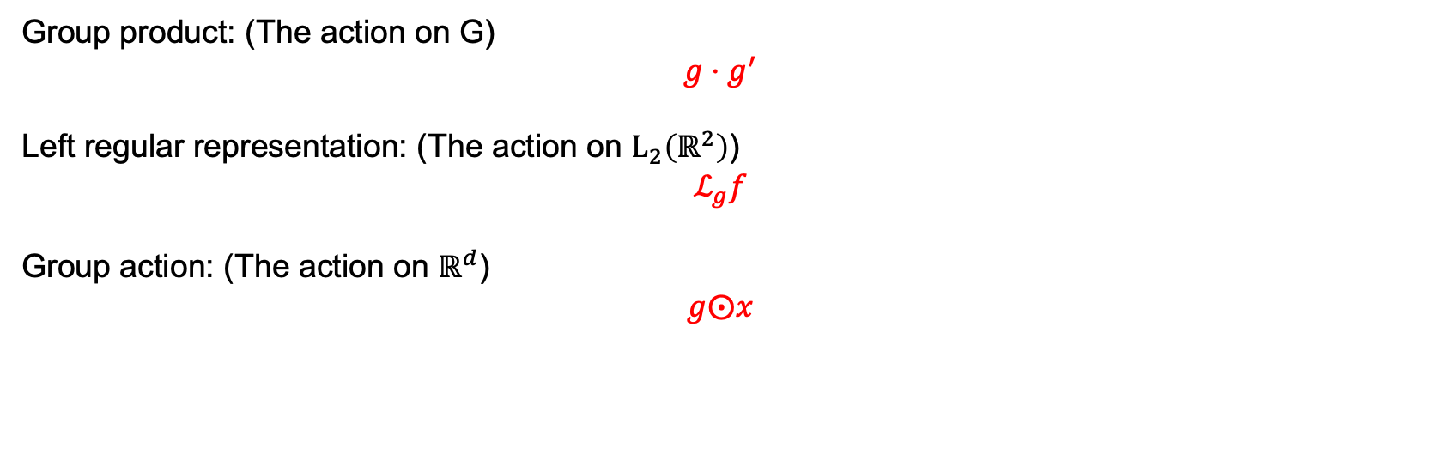
1.7 Group Actions
Group product: (The action on G)
$$g⋅g^{′}$$
Left regular representation: (The action on $L_{2}\left(ℝ^{2}\right)$)
$$ℒ_{g}f$$
Group action: (The action on $ℝ^{d}$)
$$g⨀x$$
Slide credit: E. Bekkers
Notes:
Group homomorphism: if we initially have a group here e.g. group of translation
Group representation are the transformations that respect the group structure in the following way
Plot: vector v, if we have a representation pho which is parameterized by rotation angle for example, which generate this vector. For then rotate it again, say g’ is another rotation angle. End up in this location. Could as well can be done directly by group representation of parameterized by the product of these two.
If we have two group element g and g’, we can combine them by group product.
g, h is x, x’ translation. We have group action: g*h = x+x’= x’ translation first followed up with and x translation addition
What is the general linear group? take any v, within the vector space v, we have,,,,,,,,,above

Slide 16
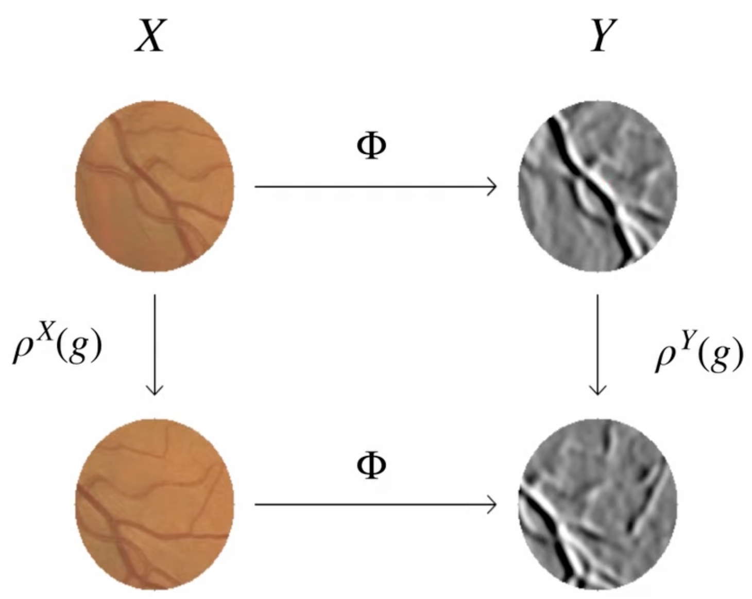
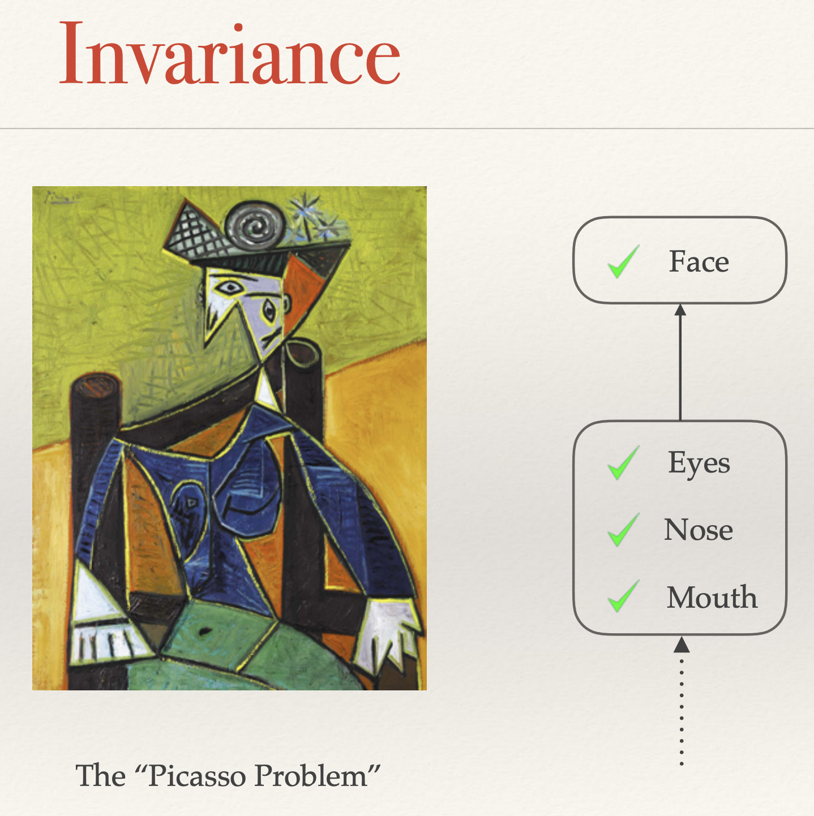
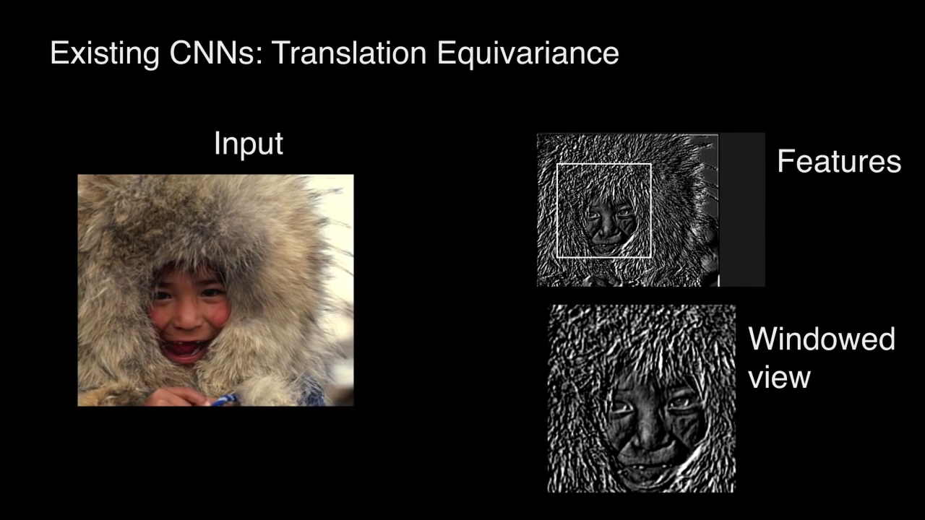
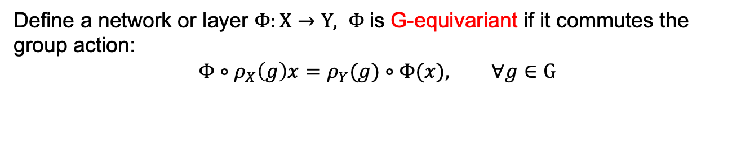
2. Group Equivariant Convolution Neural Networks
2.1 Invariance and Equivariance
Define a network or layer $Φ:X→Y, Φ$is G-equivariant if it commutes the group action:
$$Φ∘ρ_{X}\left(g\right)x=ρ_{Y}(g)∘Φ(x), ∀g∈G$$
Slide credit: E. Bekkers

Slide 17
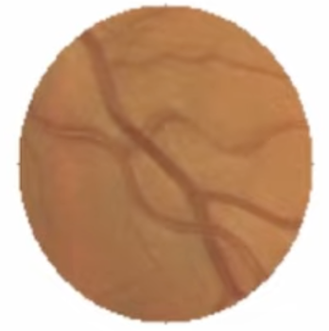
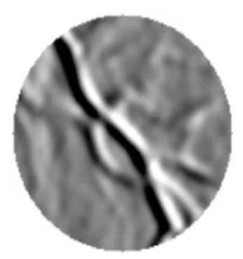
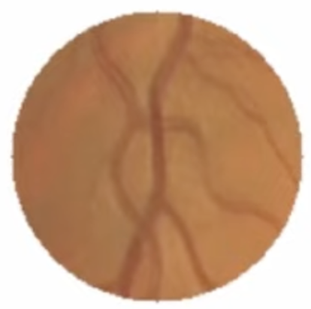
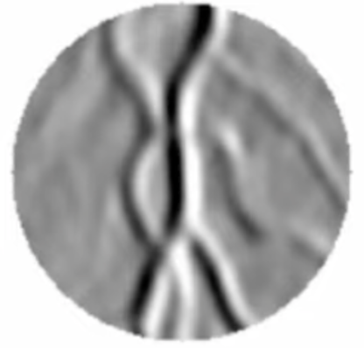
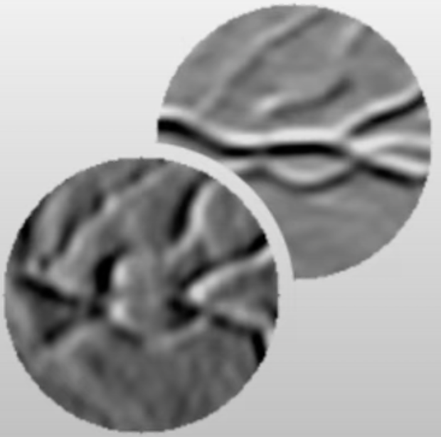
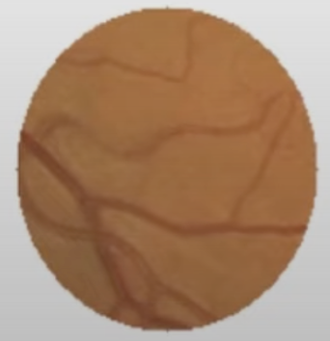
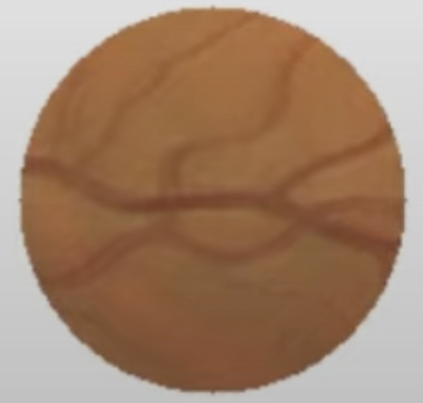
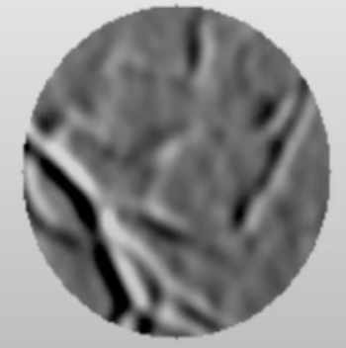
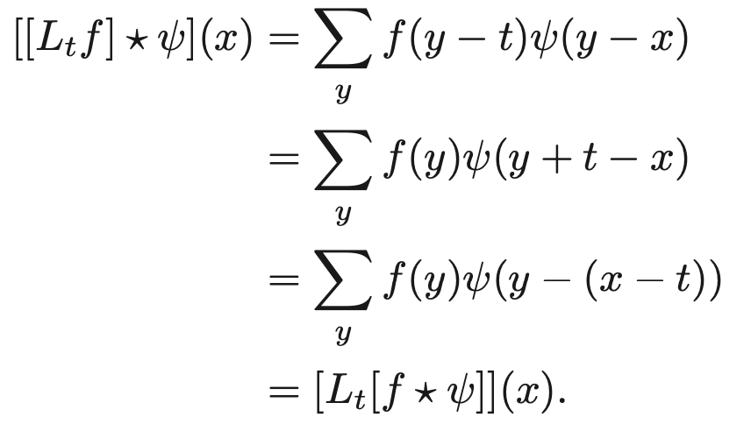
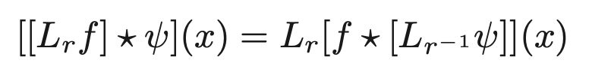
2.2 CNN is translation equivariant but not roto-translation equivariant
convolution
convolution
translation
translation
rotation
rotation
convolution
convolution
Rotation and convolution are not commute,
That is the problem we want to solve.
Slide credit: E. Bekkers

Slide 18
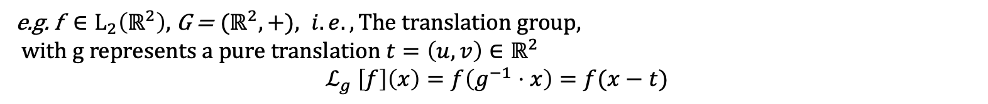
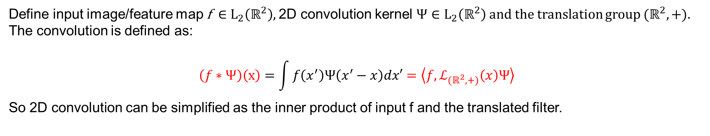
2.3 2-D convolution
Define input image/feature map f $∈L_{2}\left(ℝ^{2}\right),$2D convolution kernel $Ψ∈L_{2}\left(ℝ^{2}\right)$ and the translation group ${(ℝ}^{2},+).$ The convolution is defined as:
$$\left(f∗Ψ\right)\left(x\right)=\int{f\left(x^{′}\right)Ψ\left(x^{′}−x\right)dx′}=\left\langle {f, ℒ}_{{(ℝ}^{2},+)}\left(x\right)Ψ\right\rangle$$
So 2D convolution can be simplified as the inner product of input f and the translated filter.
e.g. f $∈L_{2}\left(ℝ^{2}\right),$ G = ${(ℝ}^{2},+), i.e.,\text{The} \text{translation} \text{group}, with g represents a pure translation t=\left(u, v\right)∈ℝ^{2}$
$$ℒ_{g} \left[f\right]\left(x\right)=f\left(g^{−1}⋅x\right)=f(x−t)$$

Slide 19
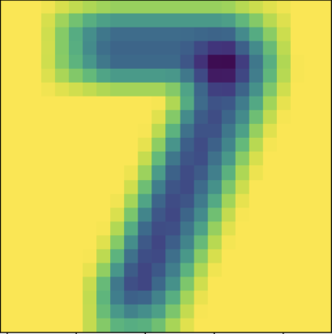

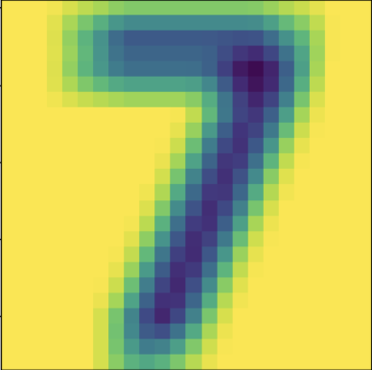
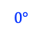
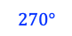
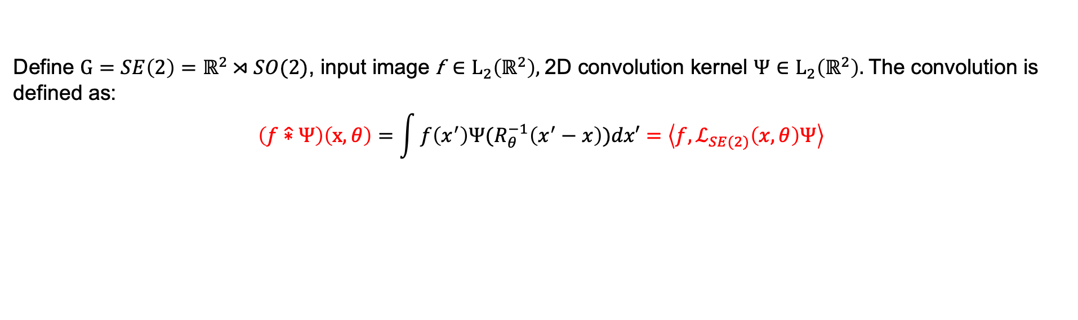
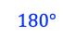
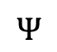


2.4 G-CNNs
2.4.1 Layer 1: SE(2) Lifting Convolution
Define $G=SE\left(2\right)=ℝ^{2}⋊SO(2)$, input image f $∈L_{2}\left(ℝ^{2}\right),$2D convolution kernel $Ψ∈L_{2}\left(ℝ^{2}\right).$ The convolution is defined as:
$$\left(f\hat{∗}Ψ\right)\left(x,θ\right)=\int{f\left(x^{′}\right)Ψ(R_{θ}^{−1}\left(x^{′}−x\right))dx′}=\left\langle {f, ℒ}_{SE(2)}\left(x,θ\right)Ψ\right\rangle$$
$$θ$$
$$0°$$
$$90°$$
Lifting Conv
$$180°$$
$$270°$$
$$Ψ$$
*
f

Slide 20
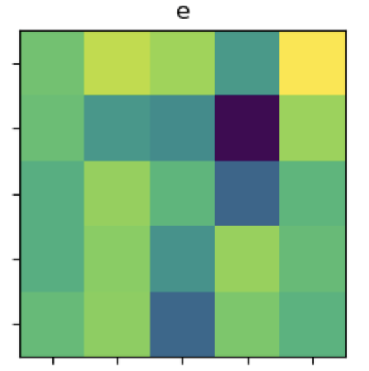
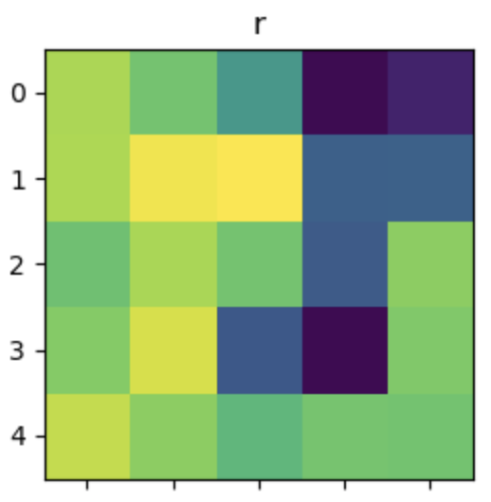
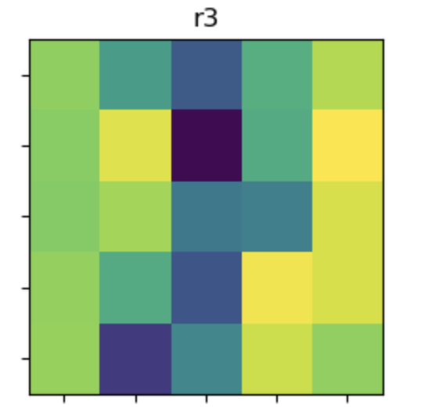
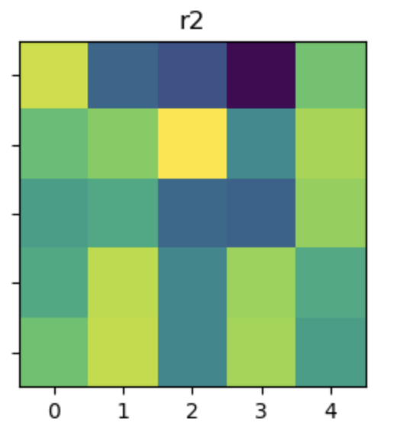
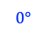
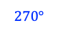




2.4.2 Layer 2: SE(2) Group Convolution
Define $G=SE\left(2\right)=ℝ^{2}⋊SO(2)$, input 3D feature map $f_{g} ∈L_{2}\left(SE(2)\right),$3D convolution kernel $Ψ_{g}∈L_{2}(SE(2)).$ The convolution is defined as:
$$\left(f_{g}\hat{∗}Ψ_{g}\right)\left(x,θ\right)=\int_{ℝ^{2}}^{ }{ }\int_{SO(2)}^{ }{f_{g}\left(x^{′}, θ^{′}\right)Ψ_{g}\left(R_{θ}^{−1}\left(x^{′}−x\right), θ−θ^{′}\right)dθdx}=\left\langle {f_{g}, ℒ}_{SE(2)}\left(x,θ\right)Ψ_{g}\right\rangle$$
$$θ$$
$$0°$$
$$90°$$
G-Conv
+ Spatial Max Pooling
Lifting Conv
$$180°$$
$$Ψ$$
$$270°$$
*
f

Slide 21

Proof of equivariance: by using substitution $h→μh$

Slide 22

2.4.3 Pointwise Non-linearities
Define the nonlinearity mapping $v:ℝ→ℝ$, composition operator $C_{v}$. Apply $v$to a feature map amounts to function composition.
$${C_{v}}_{ }f\left(g\right)=\left[v∘f\right]\left(g\right)=v(f(g))$$
$${C_{v}}_{ }L_{h}f=v∘\left(f∘h^{−1}\right)=\left[v∘f\right]∘h^{−1}=L_{h}C_{v}f$$
So the rectified feature map inherits the transformation properties of the previous layer, which is also equivariant.

Slide 23

2.4.4 Subgroup Pooling and Coset Pooling
Define the pooling operator $P$ applied to a feature map $f:G→ℝ$.
$$Pf\left(g\right)=\max_{k∈gH}{f\left(k\right)} s.t. gH=\left\{gh | h∈H\right\}, left cosets of H in G, g∈G, H⊂G$$
$$PL_{h}f=L_{h}Pf$$
Pooling commutes with group action $L_{h}$. We can obtain full G-equivariance by choosing $H$ which is a subgroup of G.

Slide 24


Slide 25
















$$θ$$
$$0°$$
$$90°$$
$$180°$$
$$270°$$
[-0.2988, -0.0289, -0.1721, -0.1802, 0.3358, 0.0529, 0.1850, -0.1459, 0.3403, 0.0621],
[-0.2988, -0.0289, -0.1721, -0.1802, 0.3358, 0.0529, 0.1850, -0.1459, 0.3403, 0.0621]
G-Conv1
+ Spatial Max Pooling
tensor([0.5279, 0.5587,
0.5501, 0.5451]
Fully Connected
Layer
Lifting Conv
Global Pooling
$$0°$$
G-Conv2
+ Spatial Max Pooling
tensor([0.5279, 0.5587,
0.5501, 0.5451]
$$Ψ$$
*
f
$$90°$$
$$180°$$
$$270°$$
min = -7.6294e-06, max = 5.7220e-06

Slide 26


Q: What if rotated by multiple of ${45}^{°}$OR any angle other than ${90}^{°}$？

Slide 27



3. Rotation-equivariant Steerable Filter CNNs
3.1 Steerable filter
A filter is rotationally steerable when its rotation by an arbitrary angle $θ$ can be expressed in a function space spanned by a fixed set of atomic basis functions ${\left\{Ψ_{q}\right\}}_{q=1}^{Q}$.
$$ψ_{1} ψ_{2} ψ_{Q}$$
Convolution Filters: linear combinations of the elementary filters.
Notes:
四个旋转做好了 为什么还要考虑SE2， since filter roated by 45 is not well-defined

Slide 28


3.2 Circular Harmonics Basis:
Define sinusoidal angular part $e^{ikΦ}$; radial function $τ\left(r\right):ℝ^{+}→ℝ$.
The circular harmonics basis is defined as:
$$Ψ_{jk}\left(r, Φ\right)=τ_{j}\left(r\right)e^{ikΦ}=τ_{j}\left(r\right)\left[\cos\left(kΦ\right)+i∙sin\left(kΦ\right)\right]$$
e.g. Choose Gaussian radial part:
$$τ_{j}\left(r\right)=exp\left(−{\left(r−μ_{j}\right)}^{2}\backslash 2σ^{2}\right), μ_{j}=j$$

Slide 29





Define angular expansion coefficient functions $k_{q}\left(θ\right)$, and rotation operator $ρ_{θ}$. The steerable filter $Ψ:ℝ^{2}→ℝ$ satisfies:
$$ρ_{θ}Ψ\left(x\right)=Ψ\left(ρ_{−θ}x\right)=\sum_{q=1}^{Q}{k_{q}\left(θ\right)Ψ_{q}(x)}, θ∈(−π,π]$$
The composed filter can be steered as a whole (by phase manipulation of the atoms):
e.g. Circular Harmonics Basis
$ρ_{θ}\hat{Ψ}(x)=\sum_{j=1}^{J}{ \sum_{k=0}^{K_{j}}{w_{jk}e^{−ikθ}Ψ_{jk}(x)}}$
$$\hat{Ψ}(x)：$$
$$ρ_{θ}\hat{Ψ}(x)：$$

Slide 30

Pros of Steerability:
Does not suffer from interpolation artifacts compared to rotations by interpolation.
In practice, response of each orientation can be synthesized from the atomic responses $f∗Ψ_{q}$:
$$(f∗ρ_{θ}Ψ)(x)=\sum_{q=1}^{Q}{k_{q}\left(θ\right)(f∗Ψ_{q})(x)}, θ∈(−π,π]$$

Slide 31




Given: Steerable Filter Basis
Step 1: Initialize W:
Step 2: Filter Assembling:

Slide 32


Q: What if we want a network:
invariant to scale change + translation equivariant?
e.g. image segmentation
Slide credit: I. Sosnovik, M. Szmaja, A Smeulders

Slide 33

CNNs are NOT Scale-Equivariant

Slide 34

4. Scale-Equivariant Steerable Filter CNNs
4.1 Scale-Equivariant Mapping:
Given the function $f\left(s,t\right)$ and a steerable filter $Ψ_{σ}\left(s,t\right)$ defined on $G=ℝ^{2}⋊ℝ^{+}$. A scale convolution is given by:
$$\left[f∗_{H}Ψ_{σ}\right]\left(s,t\right)=\int_{G}^{ }{f\left(s^{′},t^{′}\right)L_{st}\left[Ψ_{σ}\right]\left(s^{′},t^{′}\right)d}μ\left(g\right)$$
$$= \sum_{s′}^{ }{\int_{T }^{ }{f\left(s^{′},t^{′}\right)Ψ_{sσ}\left(s^{−1}s^{′},t^{′}−t\right)dt′}}$$
$$=\sum_{s′}^{ }{[f\left(s^{′},∙\right)∗Ψ_{sσ}(s^{−1}s^{′},∙)](t)}$$

Slide 35

4.2 Proof of Equivariant to Translation:

Slide 36

4.3 Proof of Equivariant to Scale Transformation:

Slide 37

4.4 Proof of Equivariance of Convolution to Transformation from $G=ℝ^{2}⋊ℝ^{+}$:
By the property of semidirect product of groups:
4.5 Basis:
Define A is a constant independent on $σ$, $H_{n}$----Hermite polynomial of the $n$-th order.
We iterate over increasing pairs of n, m to generate required number of functions.

Slide 38




Q: Scaling effect in reality is not always exact. What is the robustness of equivariance to input deformation?

Slide 39


5. Stability of equivariant representation to deformation
Under some mild assumptions, define $D_{τ }$be a nonlinear spatial deformation, let ${D_{β, v}, T_{β, v}}_{ }$be the ‘perfect’ arbitrary
scaling centered at $v∈ℝ_{+}$. We have, for any L,
convolution
translation
translation
convolution
Improvement:
Zhu, W and Qiu, Q and Calderbank, R and Sapiro, G and Cheng, X. Scaling-Translation-Equivariant Networks with Decomposed Convolutional Filters, JMLR 2022.

Slide 40
6. Experiment on Fashion-MNIST Dataset
6.1 G-CNNs v.s. CNNs:
# of epochs: 50
Batch size: 64
Learning rate: 0.01
Optimizer: Adam with decaying rate 1e-4
Training Data:
Testing Data:
CNNs: # of parameters: 9650
G-CNNs: # of parameters: 6755
Accuracy of the network: 26.0%
Accuracy of t-shirt: 22.4%
Accuracy of trouser: 35.2%
Accuracy of pullover: 19.8%
Accuracy of dress: 23.6%
Accuracy of coat: 20.0%
Accuracy of sandal: 35.6%
Accuracy of shirt: 26.8%
Accuracy of sneaker: 16.8%
Accuracy of bag: 35.7%
Accuracy of ankle boot: 26.3%
Accuracy of the network: 77.1%
Accuracy of t-shirt: 74.6%
Accuracy of trouser: 94.3%
Accuracy of pullover: 50.9%
Accuracy of dress: 76.2%
Accuracy of coat: 64.0%
Accuracy of sandal: 86.1%
Accuracy of shirt: 61.2%
Accuracy of sneaker: 93.3%
Accuracy of bag: 77.1%
Accuracy of ankle boot: 93.2%

Slide 41
6.2 R-SFCNNs v.s. CNNs:
Training Data:
# of epochs: 50
Batch size: 64
Learning rate: 0.01
Optimizer: Adam with decaying rate 1e-4
Testing Data:
R-SFCNNs: # of parameters: 10939
CNNs: # of parameters: 11650
Accuracy of the network: 74.5%
Accuracy of t-shirt: 78.00%
Accuracy of trouser: 94.6%
Accuracy of pullover: 59.8%
Accuracy of dress: 84.7%
Accuracy of coat: 48.8%
Accuracy of sandal: 86.2%
Accuracy of shirt: 39.6%
Accuracy of sneaker: 92.0%
Accuracy of bag: 76.8%
Accuracy of ankle boot: 87.2%
Accuracy of the network: 60.6%
Accuracy of t-shirt: 57.0%
Accuracy of trouser: 79.1%
Accuracy of pullover: 67.6%
Accuracy of dress: 65.6%
Accuracy of coat: 52.2%
Accuracy of sandal: 82.8%
Accuracy of shirt: 4.12%
Accuracy of sneaker: 87.4%
Accuracy of bag: 37.9%
Accuracy of ankle boot: 74.7%

Slide 42
7. Future Direction
Sample Complexity Analysis
Implicit Bias
Equivariant Model in Scientific Computing
e.g. fluid mechanics ---turbulence closure model
Notes:
Sample complexity Analysis: e.g if want to reach same results, need to theoretically explain why we have these improvement: how much training sample can get the same accuracy Implicit Bias: Now we have a model, but we don’t know what the model will be converged to after the training---paper Wei review: Wei has some analysis, but still in a simple setting---linear model e.g. what if non-linear model?
sample Equivariant model in scientific computing: fluid mechanics ---turbulence closure model, the scale that cannot be resolved, we use ML to learn. If grid is smaller, we have higher resolution of the image of the fluid(e.g., 2d), 1024 v.s. 64 grid-----how do we resolve a 64x64 grid of fluid to a 1024x1024. Need to model each points on the grid as a tensor, so rotation of the fluid cannot be the trivial rotation of image, it is rotation of the matrix of each tensor, which is a group action not left regular representation.

